Slide 1

PREDICTION ON RISK CATEGORY OF THE APPLICANTS FOR INSURANCE
Submitted by : Vijay Mukkala

Slide 2
AGENDA
Business Problem
About Dataset
Exploratory Data Analysis
Model Building
Model Evaluation
Feature Importance
Conclusion

Slide 3

1. Business Problem
In the life insurance application process, customers provide extensive information to identify risk classification and eligibility and the whole process takes an average of 30 days.
Aim : Develop a predictive model that accurately classifies risk and find out which features have greater importance in prediction.

Slide 4
2. About Dataset
The dataset comprises of 59381 observations of 128 feature columns.
Dataset consists of:
Categorical variables
Discrete Variables
Dummy Variables
Continuous Variables
The target variable is Response which is multiclass categorical variable
of ordinal type [1,2,3,4,5,6,7,8]

Slide 5
3. Exploratory Data Analysis
This dataset has lot of data handling to be done.
Dealing with Missing values :
features more than 50% missing data, we are going to drop .
features less than 50 % missing data, we are going to keep.
if the feature is categorical, replace value with Mode
if the feature is continuous, replace value with Mean
Feature Engineering :
Drop columns like ‘ID’ which are not required for analysis
Performed standardization for all the categorical features having more than 3 categories
Binary transformation of the categorical features having 3 or less categories
Combining all the data into one Dataframe for building the model

Slide 6
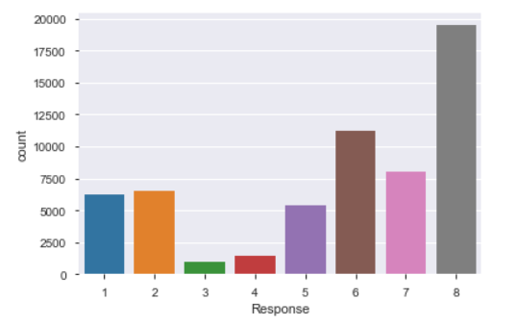
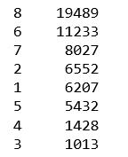
3. Exploratory Data Analysis
3. Exploratory Data Analysis
Distribution of Target variable “Response’

Slide 7

4. Model Building
4. Model Building
Splitting the data into Explanatory variables(X) and target variable(y)
Splitting X & y into training and test datasets (Cross-validation)
Building model : Load and will fit the training data into the following models
Logistic Regression
Random Forest classification

Slide 8


5. Model Evaluation
Loss function :
For Logistic Regression : Cross- Entropy
For Random Forest : Entropy/GINI
Metrics used to evaluate these models are :
Accuracy score
Confusion matrix
ACCURACY SCORE
1. Logistic Regression
2. RANDOM FOREST CLASSIFIER

Slide 9
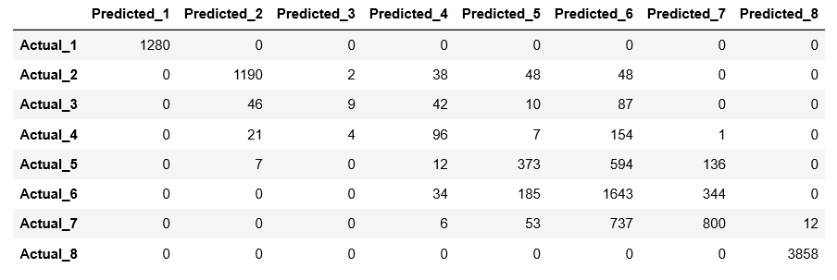
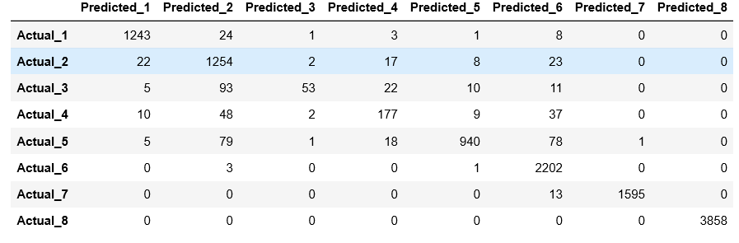
5. Model Evaluation
CONFUSION MATRIX
1. Logistic Regression
Total correct predictions :9249
2. RANDOM FOREST CLASSIFIER
Total correct predictions : 11322

Slide 10
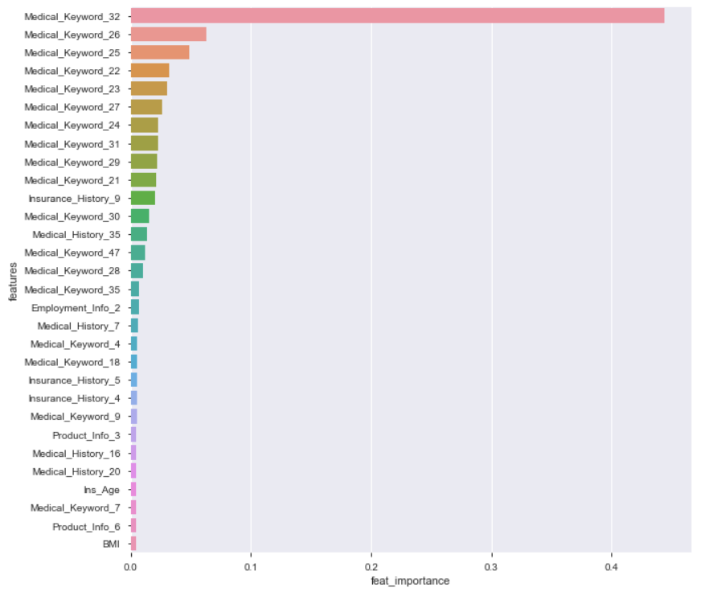
6. Feature Importance

Slide 11
7. Conclusion
We have done Exploratory data analysis and Data handling
Created different predictions using classification models Logistic regression and Random Forest algorithms.
From the accuracy(95%) and correct predictions from confusion matrix , we consider Random Forest as
the best algorithm for this data.
Found important features for building model and keep them for future reference

Slide 12


